Slide 1

Hotel Reservation Operations Analytics

Slide 2
Meet Team
Sane Jhansi
Background: B.Tech
Experience: Fresher
Linkedin:
https://www.linkedin.com/in/sane-jhansi-44060425a
GitHub:- https://github.com/sanejhansi
Uppu Srujana Sri
Background: B.Tech
Experience: Fresher
Linkedin:
https://www.linkedin.com/in/srujanasri-uppu-785b722a2?
GitHub:
https://github.com/Srujanasri890
Chintala Akshaya
Background: B.Tech
Experience: Fresher
Linkedin:
https://www.linkedin.com/in/akshaya-chintala-524228275?
GitHub: https://github.com/AkshayaChintala

Slide 3
Table of contents
Project Overview
Business Scenario
Business Objectives
Dataset & Database Overview
ER Diagram & Database Structure
Analysis of the Objectives
Overall Key Findings
Business Recommendations
Conclusion
Q&A

Slide 4
Project Overview
This project focuses on analyzing hotel reservation operations using MySQL. The objective is to convert hotel reservation data into meaningful business insights.
The analysis covers:
Booking demand
Guest booking behaviour
Stay performance
Staff and room performance
Booking and stay problems
The project demonstrates the complete process from understanding business requirements to writing SQL queries and interpreting results.

Slide 5
Business Scenario
StayPoint Hospitality manages multiple hotels and maintains data related to guests, bookings, rooms, stays, and staff.
The company needs to analyze booking demand across hotels, booking channels, room types, and different time periods.
It also needs to understand guest booking behaviour, including booking frequency, spending, and differences between guest types.
The organization wants to evaluate stay, staff, and room performance to improve operational efficiency and resource utilization.
Finally, the company needs to identify booking and stay problems such as cancellations, no-shows, and high service requests, so that management can take appropriate action.

Slide 6
Business Objectives
Analyze booking demand to understand which hotels, booking channels, and room types receive the most bookings.
Understand guest booking behaviour by studying booking frequency, booking amounts, guest types, and booking patterns.
Evaluate stay performance by analyzing stay outcomes, duration, status, and performance across different hotels and time periods.
Measure staff and room performance to understand workload, room usage, and how effectively hotel resources are being utilized.
Identify booking and stay problems such as cancellations, no-shows, and service requests, and use the findings to support better operational decisions.

Slide 7
Dataset & Database Overview
Table / Dataset | Records | Columns | Purpose
Guests | 350 | 7 | Contains guest details and preferences
Hotels | 25 | 6 | Contains hotel details and room capacity
Rooms | 600 | 7 | Contains room details, types, occupancy, and pricing
Bookings | 2,800 | 8 | Contains guest reservation and booking details
Stays | 3,200 | 10 | Contains check-in, check-out, stay status, and service details
Staff | 70 | 6 | Contains staff details, department, rating, and active status

Slide 8
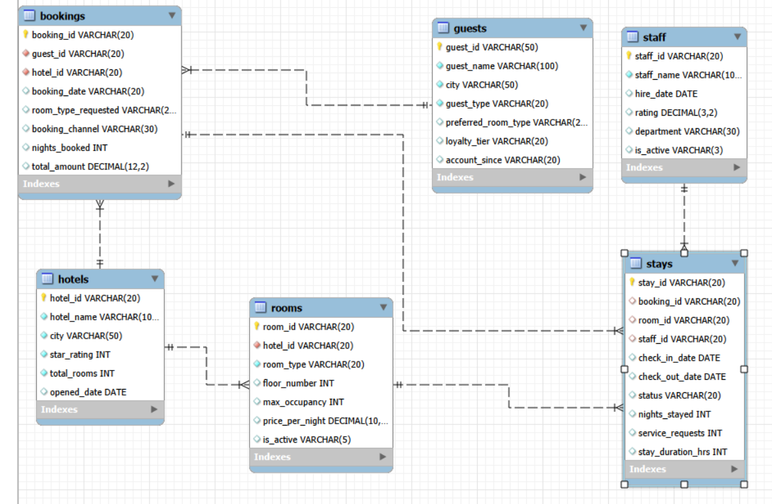
ER Diagram & Database Structure

Slide 9
Analysis of the Objectives
Objective | Analysis Performed
Booking Demand | Analyzed bookings across hotels, booking channels, room types, time periods, and booking amounts to understand booking demand.
Guest Booking Behaviour | Analyzed guest booking frequency, total booking amount, activity across hotels, guest types, and booking patterns over time.
Stay Performance | Compared stay outcomes across hotels, examined stay duration, analyzed different stay statuses, and evaluated stay performance over time.
Staff & Room Performance | Analyzed the number of stays handled by staff, staff performance, stay duration, room usage by room type, and stay performance across rooms.
Booking & Stay Problems | Analyzed cancellations, no-shows, stay status patterns, service requests, and hotels with higher booking or stay problems.

Slide 10

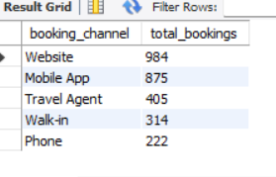
Which booking channel is most popular?
Key Insights:
The booking channel with the highest number of bookings is the most popular channel among customers. This indicates that customers prefer using that channel when making hotel reservations.

Slide 11
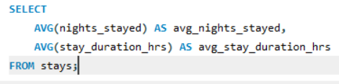
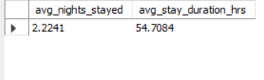
What is the average stay duration?
Key Insights:
By looking at average, minimum, and maximum nights stayed, the hotel can understand guest stay patterns and plan room availability and operations more effectively.

Slide 12
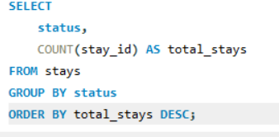
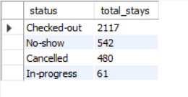
What are the different stay statuses?
Key Insights:
The query shows the number of stays under each status, status with the highest count represents the most common stay outcome, Checked-out stays indicate completed stays, In-progress stays indicate currently ongoing stays.
Cancelled and No-show stays represent potential booking or operational problems.

Slide 13

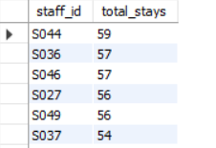
Which staff member handled the most stays?
Key Insights:
The staff member with the highest number of stays has handled the most guest stays.
This helps identify staff workload differences.
Staff members handling many stays may require proper workload monitoring to avoid overloading.
The hotel can use this analysis for better staff allocation and operational planning.

Slide 14
Overall Key Findings
Booking demand: The analysis helps identify the hotels, booking channels, and room types with higher booking activity.
Guest behaviour: The analysis shows differences in guest booking frequency, spending, hotel activity, and behaviour between Individual and Corporate guests.
Stay performance: Stay outcomes, duration, and different statuses such as Checked-out, No-show, Cancelled, and In-progress can be compared to understand overall stay performance.
Staff & room utilization: The analysis helps identify staff workload, room usage, and differences in performance across staff members and rooms.
Booking & stay problems: Cancellations, no-shows, service requests, and hotels with higher problem levels can be identified for further improvement.

Slide 15
Business Recommendations
Optimize booking channels: Focus on the booking channels that generate higher booking activity and regularly monitor their performance.
Improve room availability: Maintain sufficient availability for room types that have higher demand and use booking trends for better room planning.
Understand guest behaviour: Use guest booking patterns and spending behaviour to improve customer engagement and provide more suitable services.
Improve hotel operations: Monitor stay outcomes, staff workload, and room usage to improve operational efficiency and resource utilization.
Reduce booking and stay problems: Closely monitor cancellations, no-shows, and high service requests, and take corrective actions to improve the overall guest experience.

Slide 16
Conclusion
This project demonstrates how hotel reservation data can be analyzed using MySQL and SQL to support business decision-making.
The analysis provides an understanding of booking demand, guest booking behaviour, stay performance, staff performance, and room utilization.
It also helps identify important operational issues such as cancellations, no-shows, and service requests.
By connecting the different tables and analyzing the data through SQL queries, we can convert raw reservation data into meaningful business insights.
Overall, the project shows how a structured, data-driven approach can help StayPoint Hospitality improve its operations, utilize resources effectively, and make better business decisions

Slide 17

THANK YOU

